Slide 1
Hybrid Quantum-Classical Neural Networks
for Stock Price Forecasting
A Comparative Study of Classical and Quantum-Enhanced Models for Stock Price Prediction
Nathaniel James Pacey
For Terra Quantum

Slide 2
Table of contents
01
03
02
04
Problem Definition
Optimization
Motivation for the selection of data and methodology
Optimizing hyperparameters and architecture choices
final model description
Methodology
Results & Discussion
Data source and preprocessing, model architecture
Training & Validation
Results comparisons

Slide 3

01
Introduction
Financial time series forecasting is complex due to volatility, noise, and external factors.
Traditional machine learning models often struggle to generalize across market conditions.

Slide 4
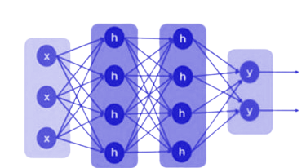
Problem Definition
To predict stock values accurately, this project leverages classical Machine Learning (ML) and Hybrid Quantum ML.
Specifically a modular hybrid model combining recurrent neural networks (RNNs) with a variational quantum layer.
Goal to investigate whether quantum-classical hybrid architectures can improve stock price prediction accuracy.
Focus on daily closing prices for AAPL, MSFT, and GOOGL from 2015–2024.

Slide 5
02
Methodology
Initial Model Design Including Data Source & Preprocessing

Slide 6


Data Source and Preprocessing
Data:
Daily closing prices for AAPL, MSFT, and GOOGL (2015–2024) via yfinance API.
Data Cleaning:
Forward-filled missing values to maintain continuity.
Min-Max normalization applied per ticker to [0, 1] range.
Data Structuring:
Sliding window of 20 time steps mapped to the next price.
Preserved short-term dependencies and momentum patterns.
Train/Test Split:
80/20 split without time leakage to maintain chronological order.
Dataset Composition:
Combined sequences across tickers to improve model diversity and generalization.

Slide 7
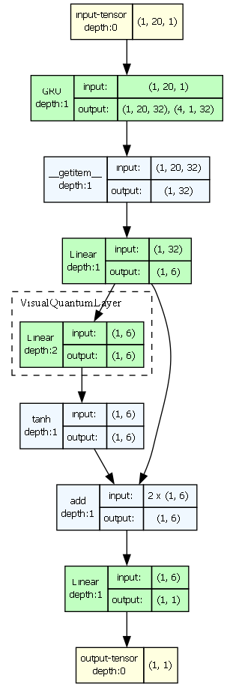
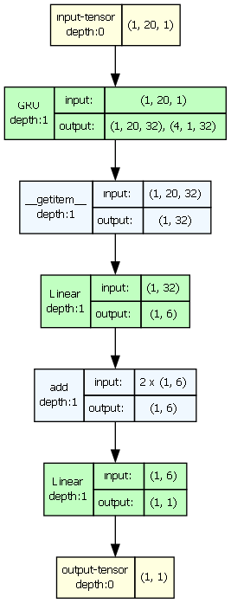
Model Architecture
Quantum Hybrid Model
Classical Model
Input Tensor: (batch size, 20, 1) — 20 time steps, 1 feature.
Recurrent Units: (LSTM, GRU, RNN — single or mixed)
Hidden State Extraction
Linear Layer (Classical Projection):
Optional Quantum Layer: Process n features through a variational quantum circuit.
Post-Quantum Activation: (e.g., Tanh, Sigmoid, ReLU).
Skip Connection (Add or Concat): Merge classical and quantum feature vectors.
Final Linear Layer: Compress merged 6 features → 1 scalar output.
Final Activation: (e.g., Tanh, Sigmoid, ReLU)
Output Tensor: Shape (batch size, 1) — Predicted stock price.
Notes:
Model Forward Pass Overview
Input Tensor: Shape (batch size, 20, 1) — 20 time steps, 1 feature.
Recurrent Units (LSTM, GRU, RNN — single or mixed): Process sequence → Output hidden states (batch size, 20, 32) and final hidden state (batch size, 4, 1, 32).
Hidden State Extraction: Reshape final hidden state to (batch size, 32).
Linear Layer (Classical Projection): Map 32 features → 6 features (for input to optional quantum layer).
Optional Quantum Layer: Process n features through a variational quantum circuit.
The n features after the Linear projection are mapped to match the number of qubits used in your optional quantum layer.
Post-Quantum Activation: Apply non-linear activation (e.g., Tanh, Sigmoid, ReLU).
Skip Connection (Add or Concat): Merge classical and quantum feature vectors (both of size 6).
Final Linear Layer: Compress merged 6 features → 1 scalar output.
Output Tensor: Shape (batch size, 1) — Predicted stock price.

Slide 8
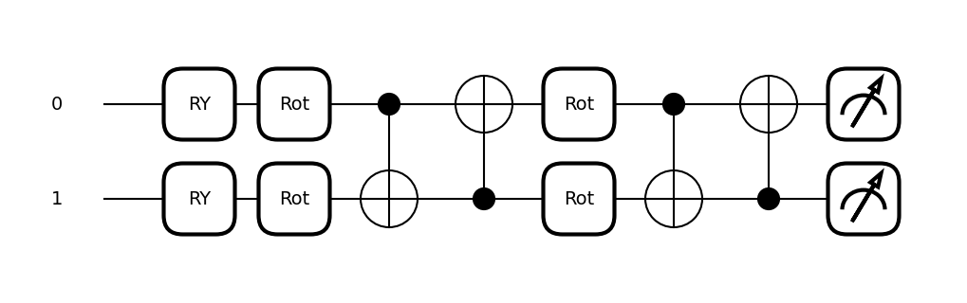
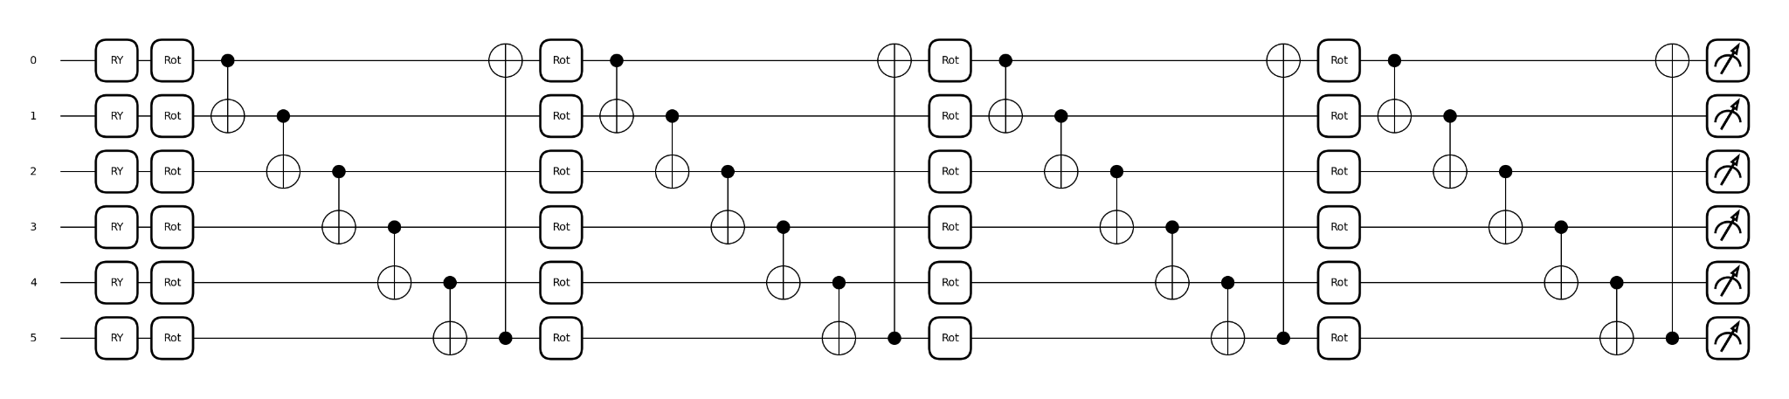
Quantum Layer - Variational Quantum Circuit
Simple Variational Quantum Circuit:
2 qubits, 2 layers (Q-depth = 2)
Final Variational Quantum Circuit:
6 qubits, 4 layers (Q-depth = 4)
Notes:
If the quantum layer is enabled, the projected features are passed through a variational quantum circuit (built using PennyLane’s QNode interface, as shown in Figure 1 [8]), where each feature is encoded via an RY gate [9]. Across a configurable number of variational layers (q depth), each qubit undergoes a parameterized rotation: After each layer, qubits are entangled via a ring of CNOT gates to create a circular topology [10]. The output is obtained by measuring the expectation value of PauliZ on each qubit, producing a real-valued vector.

Slide 9
03
Optimization
Training Strategy, Hyper Parameter and Architecture Optimization

Slide 10
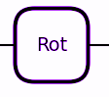
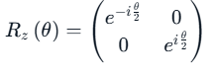
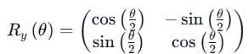
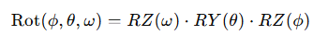
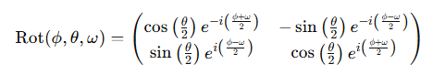
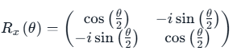
Quantum Circuit Optimization
Parameterized Rotation
=
3 Parameters:
1 Parameter:
2 Parameters:
Notes:
either RY (1 parameter), RX + RZ (2 parameters), or Rot (3 parameters).

Slide 11
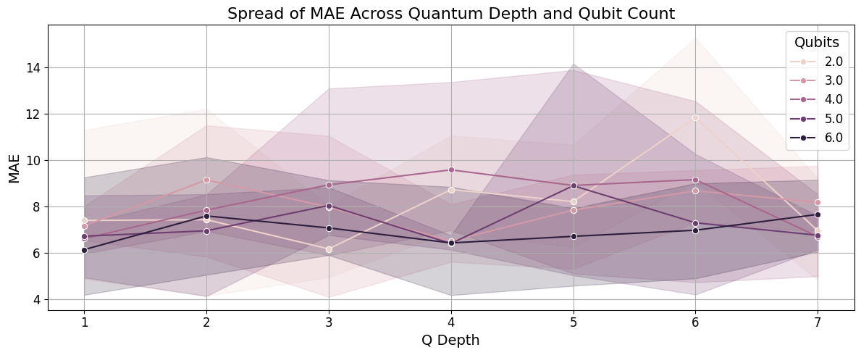
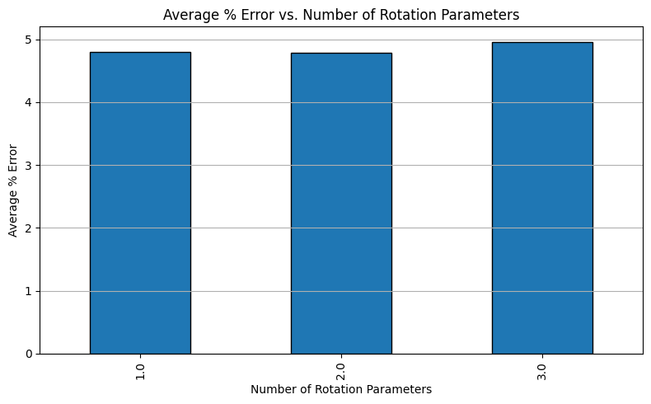
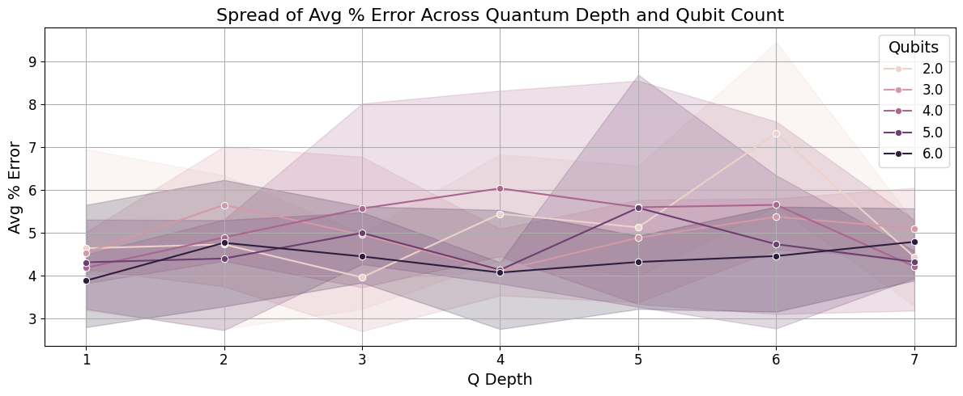
Quantum Circuit Optimization
Quantum Circuit Grid Search
Number of Qubits (2–6), circuit depth (1–7), and gate complexity (1–3 parameters)
Notes:
either RY (1 parameter), RX + RZ (2 parameters), or Rot (3 parameters).

Slide 12
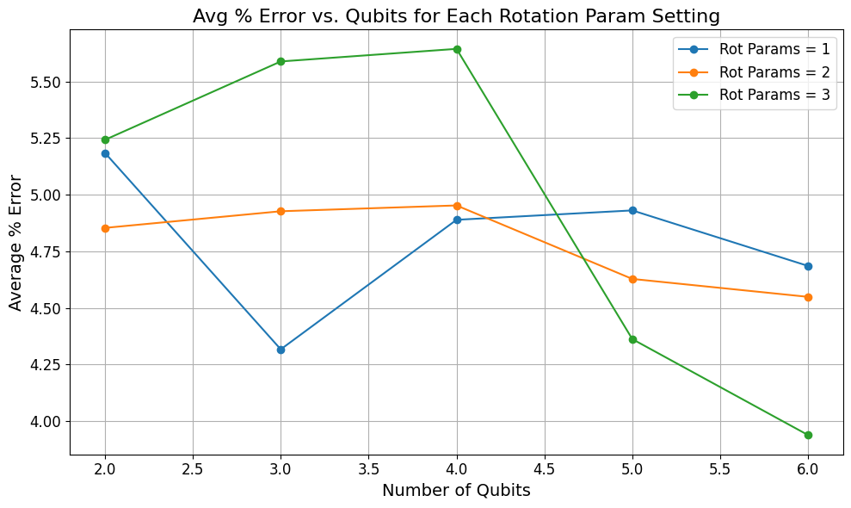
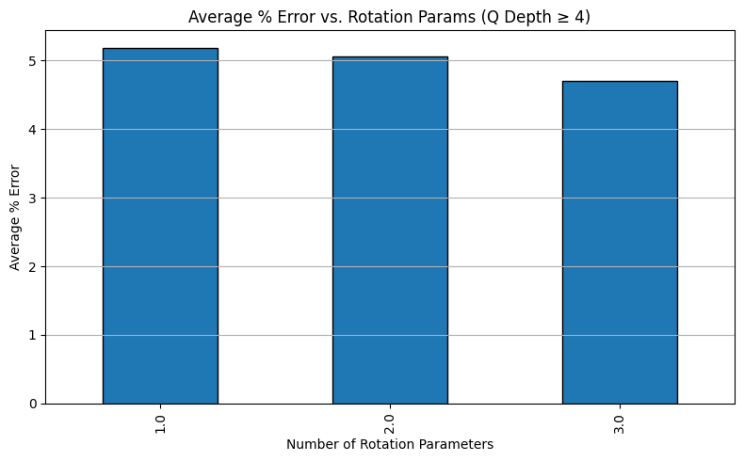
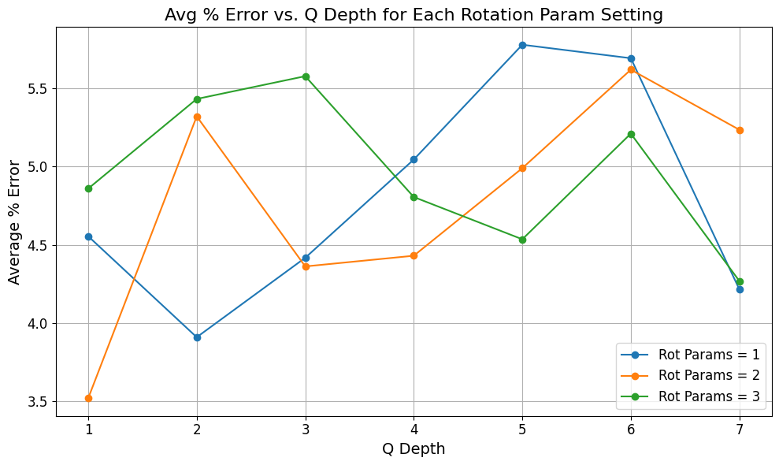
Quantum Circuit Optimization
Threshold
Quantum Circuit Grid Search
Focus on where a Full Rotation outperforms
Notes:
either RY (1 parameter), RX + RZ (2 parameters), or Rot (3 parameters).

Slide 13
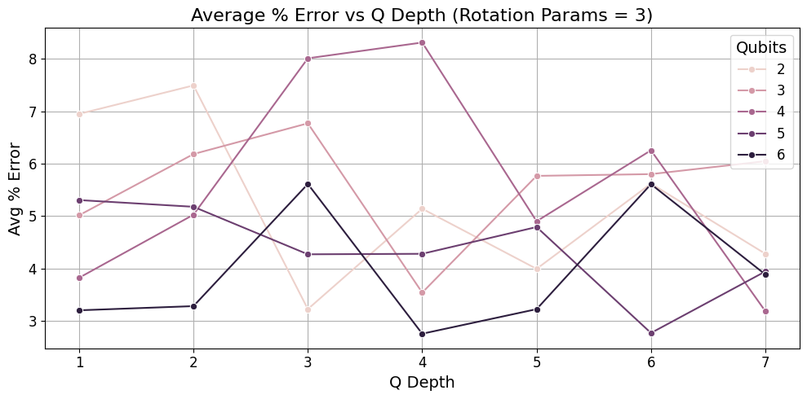
Quantum Circuit Optimization
Final Selection
Final Variational Quantum Circuit:
6 qubits, 4 layers (Q-depth = 4), Full Rotation Gate
Notes:
either RY (1 parameter), RX + RZ (2 parameters), or Rot (3 parameters).

Slide 14

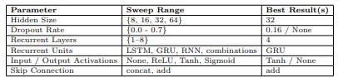
Classical Architecture Optimization
Classical components optimized separately to reduce quantum training time.
Parameter sweeps with modular Python scripts; one parameter varied at a time. Results saved in Excel.
Coarse-grained sweeps followed by fine-grained searches for refinement.
Best configurations selected based on MAE, RMSE, and average percentage error.
Final Configuration: GRU units, 4 layers, hidden size = 32, add skip connection, Tanh post-quantum activation, no dropout.

Slide 15
04
Results
Evaluation of Hybrid Model and Comparison to Classical Model

Slide 16
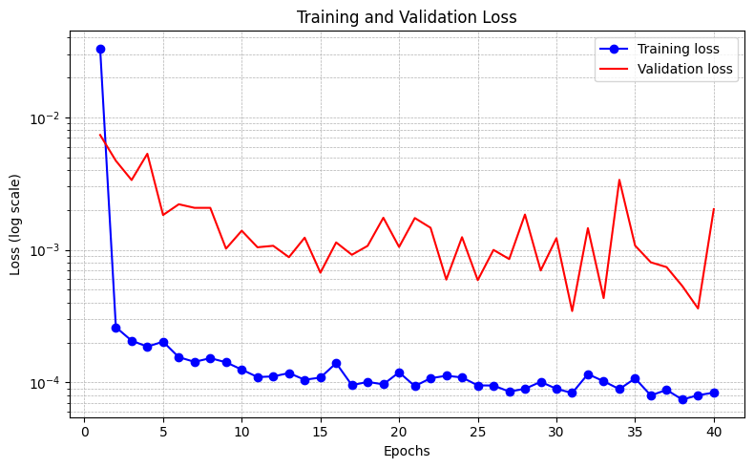
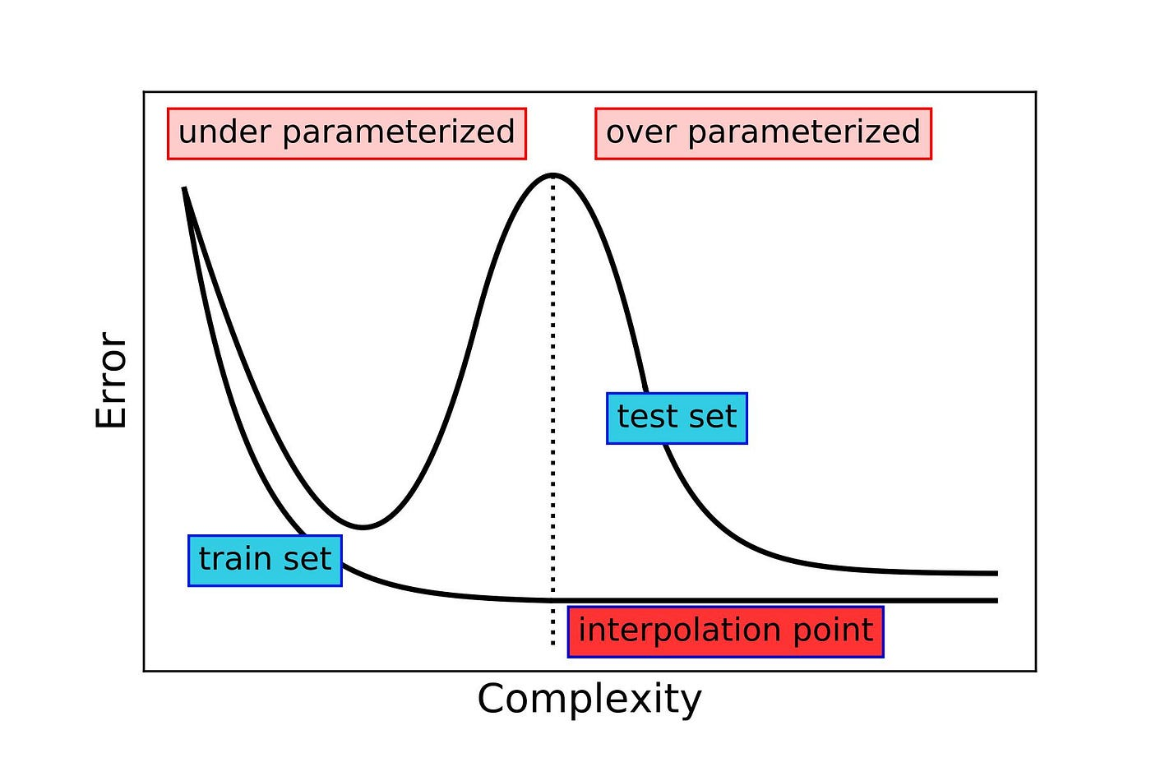
Training & Validation
Hybrid models trained for 40 epochs, achieving a best training loss of 0.000083 and validation loss of 0.000346.
Overfitting and Model Complexity:
Higher validation loss suggests overfitting or possible double descent behavior; further tuning of model depth, quantum circuit size, and training duration is required.
Notes:
Model Forward Pass Overview
Input Tensor: Shape (batch size, 20, 1) — 20 time steps, 1 feature.
Recurrent Units (LSTM, GRU, RNN — single or mixed): Process sequence → Output hidden states (batch size, 20, 32) and final hidden state (batch size, 4, 1, 32).
Hidden State Extraction: Reshape final hidden state to (batch size, 32).
Linear Layer (Classical Projection): Map 32 features → 6 features (for input to optional quantum layer).
Optional Quantum Layer: Process n features through a variational quantum circuit.
The n features after the Linear projection are mapped to match the number of qubits used in your optional quantum layer.
Post-Quantum Activation: Apply non-linear activation (e.g., Tanh, Sigmoid, ReLU).
Skip Connection (Add or Concat): Merge classical and quantum feature vectors (both of size 6).
Final Linear Layer: Compress merged 6 features → 1 scalar output.
Output Tensor: Shape (batch size, 1) — Predicted stock price.

Slide 17
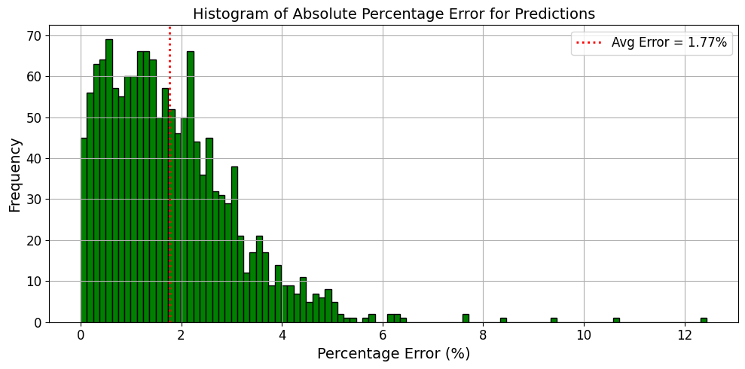
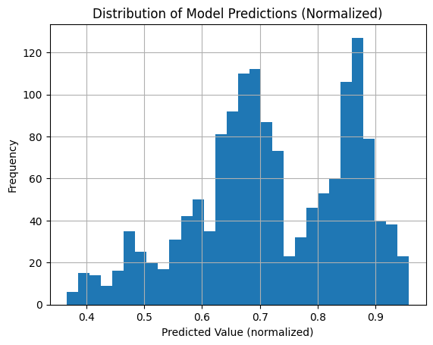
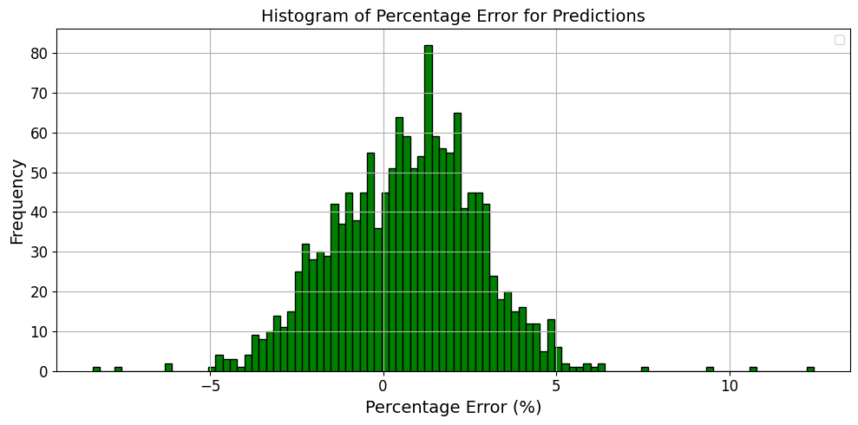
Hybrid Model Predictions
Predictions Distribution: Ranges over full 0 to 1 with two distinct peaks
Model Evaluation Metrics: Test MAE = 2.5660, Test RMSE = 3.1719, and Average Absolute Percentage Error = 1.77%.
Error Distribution Analysis: Most prediction errors fall within 0–2%, centered near 0%, indicating high accuracy and minimal bias.
Notes:
Model Forward Pass Overview
Input Tensor: Shape (batch size, 20, 1) — 20 time steps, 1 feature.
Recurrent Units (LSTM, GRU, RNN — single or mixed): Process sequence → Output hidden states (batch size, 20, 32) and final hidden state (batch size, 4, 1, 32).
Hidden State Extraction: Reshape final hidden state to (batch size, 32).
Linear Layer (Classical Projection): Map 32 features → 6 features (for input to optional quantum layer).
Optional Quantum Layer: Process n features through a variational quantum circuit.
The n features after the Linear projection are mapped to match the number of qubits used in your optional quantum layer.
Post-Quantum Activation: Apply non-linear activation (e.g., Tanh, Sigmoid, ReLU).
Skip Connection (Add or Concat): Merge classical and quantum feature vectors (both of size 6).
Final Linear Layer: Compress merged 6 features → 1 scalar output.
Output Tensor: Shape (batch size, 1) — Predicted stock price.

Slide 18
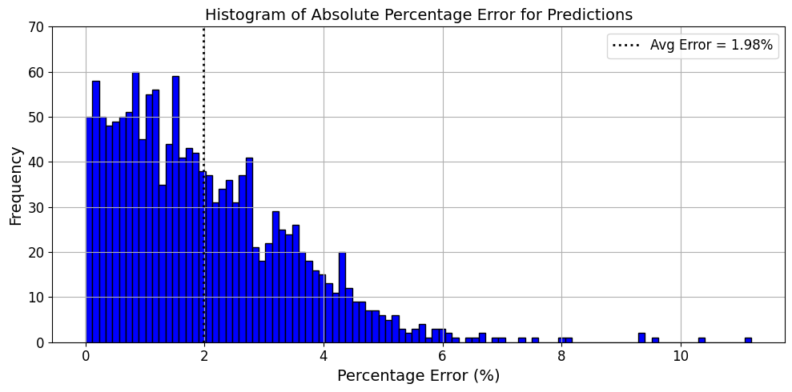
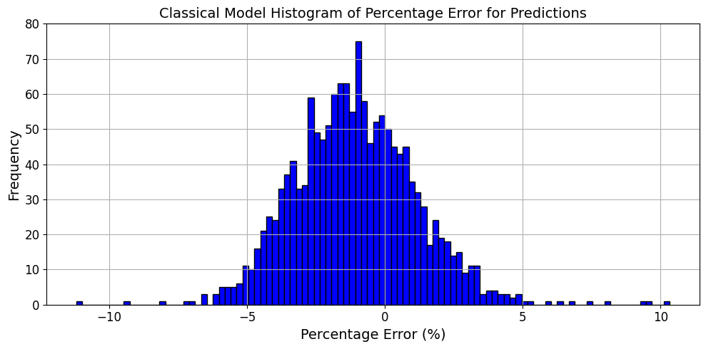
Predictions
Comparison
Classical Model
Metric | Hybrid Model | Classical Model
Test MAE | 2.566 | 3.0522
Test RMSE | 3.1719 | 3.9727
Average Absolute Percentage Error | 1.77% | 1.98%
Hybrid Quantum Model
Notes:
Model Forward Pass Overview
Input Tensor: Shape (batch size, 20, 1) — 20 time steps, 1 feature.
Recurrent Units (LSTM, GRU, RNN — single or mixed): Process sequence → Output hidden states (batch size, 20, 32) and final hidden state (batch size, 4, 1, 32).
Hidden State Extraction: Reshape final hidden state to (batch size, 32).
Linear Layer (Classical Projection): Map 32 features → 6 features (for input to optional quantum layer).
Optional Quantum Layer: Process n features through a variational quantum circuit.
The n features after the Linear projection are mapped to match the number of qubits used in your optional quantum layer.
Post-Quantum Activation: Apply non-linear activation (e.g., Tanh, Sigmoid, ReLU).
Skip Connection (Add or Concat): Merge classical and quantum feature vectors (both of size 6).
Final Linear Layer: Compress merged 6 features → 1 scalar output.
Output Tensor: Shape (batch size, 1) — Predicted stock price.

Slide 19
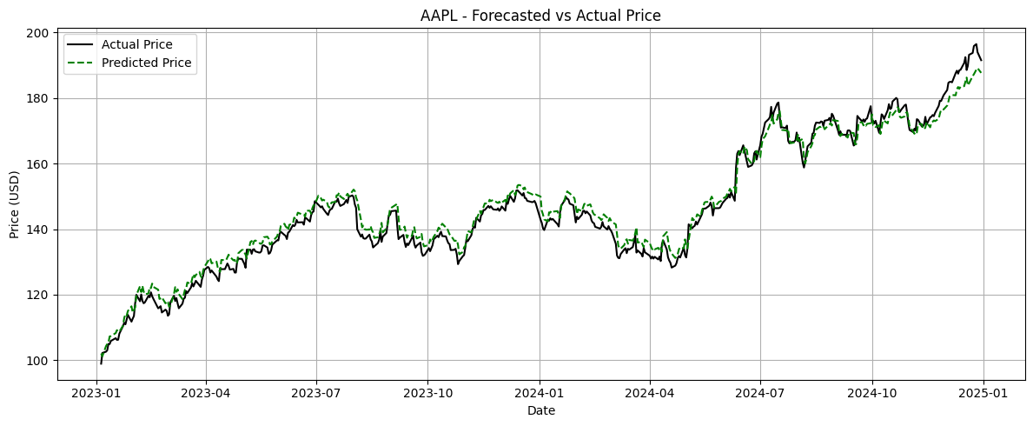
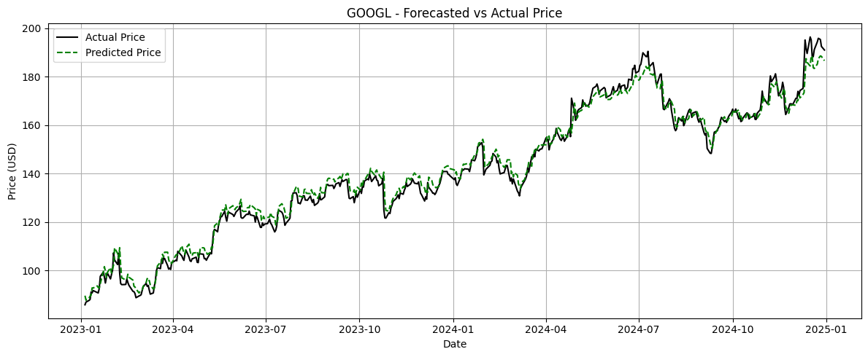
Hybrid Model Price Predictions
Notes:
Model Forward Pass Overview
Input Tensor: Shape (batch size, 20, 1) — 20 time steps, 1 feature.
Recurrent Units (LSTM, GRU, RNN — single or mixed): Process sequence → Output hidden states (batch size, 20, 32) and final hidden state (batch size, 4, 1, 32).
Hidden State Extraction: Reshape final hidden state to (batch size, 32).
Linear Layer (Classical Projection): Map 32 features → 6 features (for input to optional quantum layer).
Optional Quantum Layer: Process n features through a variational quantum circuit.
The n features after the Linear projection are mapped to match the number of qubits used in your optional quantum layer.
Post-Quantum Activation: Apply non-linear activation (e.g., Tanh, Sigmoid, ReLU).
Skip Connection (Add or Concat): Merge classical and quantum feature vectors (both of size 6).
Final Linear Layer: Compress merged 6 features → 1 scalar output.
Output Tensor: Shape (batch size, 1) — Predicted stock price.

Slide 20
Conclusions & Future Work
Metric | Hybrid Model | Classical Model
Test MAE | 2.566 | 3.0522
Test RMSE | 3.1719 | 3.9727
Average Absolute Percentage Error | 1.77% | 1.98%
Conclusion
Hybrid model showed slight improvement over classical, but within typical uncertainty ranges.
No definitive advantage of the quantum layer yet; further validation needed across more datasets.
Future Work
Accelerate training using parallelization, GPU support, or cloud quantum platforms.
Optimize additional hyperparameters (e.g., learning rate) and explore alternative quantum circuit designs.
Expand dataset to include more stock tickers and additional features.
Test hybrid models on real quantum hardware and different quantum platforms (e.g., Qiskit).
Evaluate model performance on live or unseen financial data for real-world validation.
Notes:
Model Forward Pass Overview
Input Tensor: Shape (batch size, 20, 1) — 20 time steps, 1 feature.
Recurrent Units (LSTM, GRU, RNN — single or mixed): Process sequence → Output hidden states (batch size, 20, 32) and final hidden state (batch size, 4, 1, 32).
Hidden State Extraction: Reshape final hidden state to (batch size, 32).
Linear Layer (Classical Projection): Map 32 features → 6 features (for input to optional quantum layer).
Optional Quantum Layer: Process n features through a variational quantum circuit.
The n features after the Linear projection are mapped to match the number of qubits used in your optional quantum layer.
Post-Quantum Activation: Apply non-linear activation (e.g., Tanh, Sigmoid, ReLU).
Skip Connection (Add or Concat): Merge classical and quantum feature vectors (both of size 6).
Final Linear Layer: Compress merged 6 features → 1 scalar output.
Output Tensor: Shape (batch size, 1) — Predicted stock price.

Slide 21
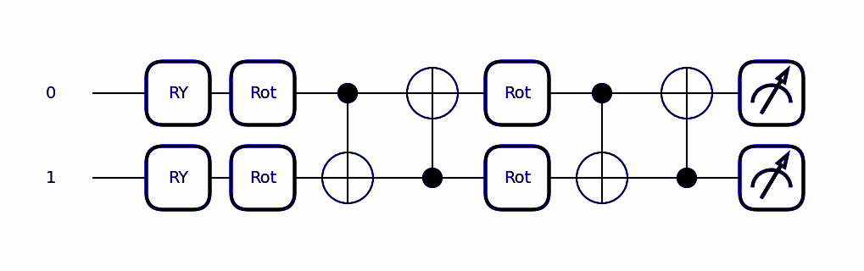
Thank you!
Do you have any questions?

